Slide 1
Simple PyTorch Image recognization

Slide 2
Define PyTorch
PyTorch is a fully featured framework for building deep learning models, which is a type of machine learning that's commonly used in applications like image recognition and language processing.
Written in Python, it's relatively easy for most machine learning developers to learn and use.

Slide 3
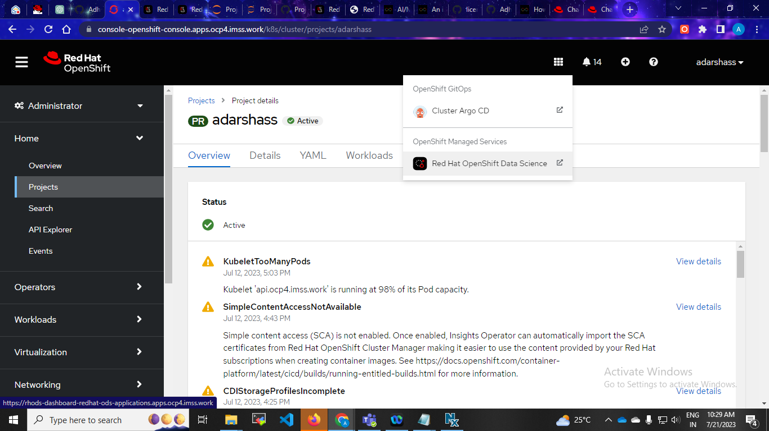
Step1: create namespace Step2: install red hat openshift data science operator step3:open operator

Slide 4
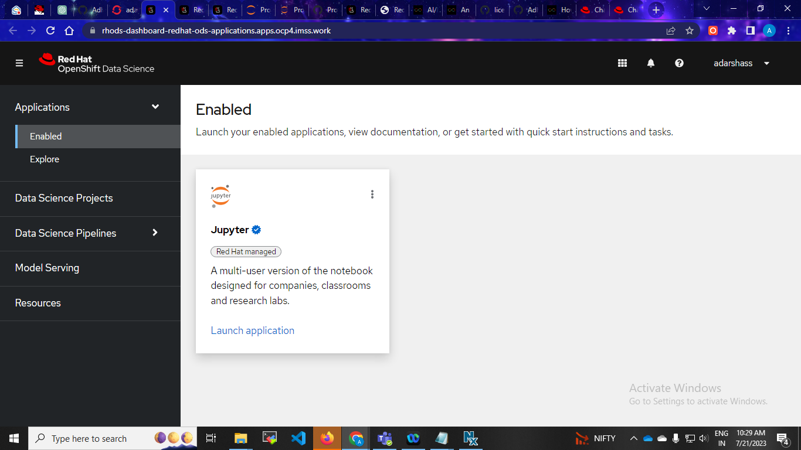
Step4:launch jupyter notebook

Slide 5

Step4: select PyTorch new version and size medium

Slide 6
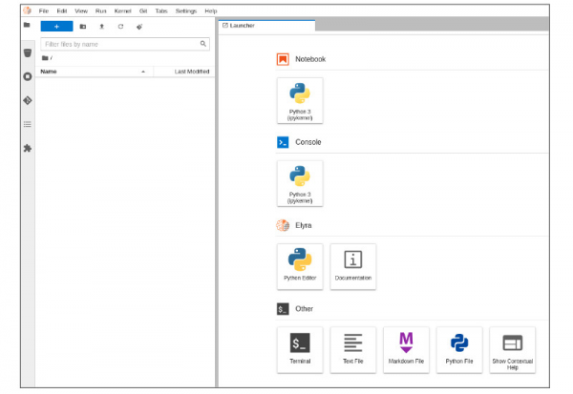
Step6: Jupyter workspace--The Name explorer panel in a JupyterLab workspace shows available options.

Slide 7
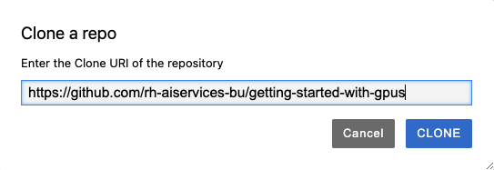
Step7: Select the Git/Clone a Repository menu option

Slide 8
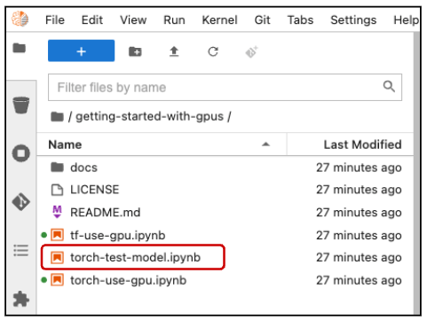
The getting-started-with-gpus repository contents

Slide 9
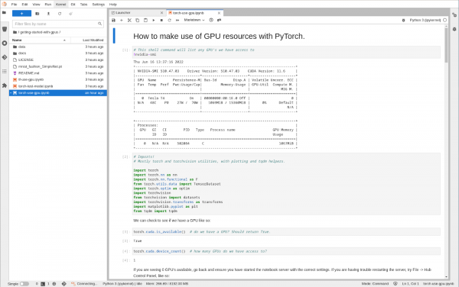
Step8: The torch-use-gpu.ipynb jupyter notebook displays Python code with comments.

Slide 10
This notebook handles the following tasks:
Importing torch libraries (utilities).
Listing available GPUs.
Checking that GPUs are enabled.
Assigning a GPU device and retrieve the GPU name.
Loading vectors, matrices, and data onto a GPU.
Loading a neural network model onto a GPU.
Training the neural network model.

Slide 11
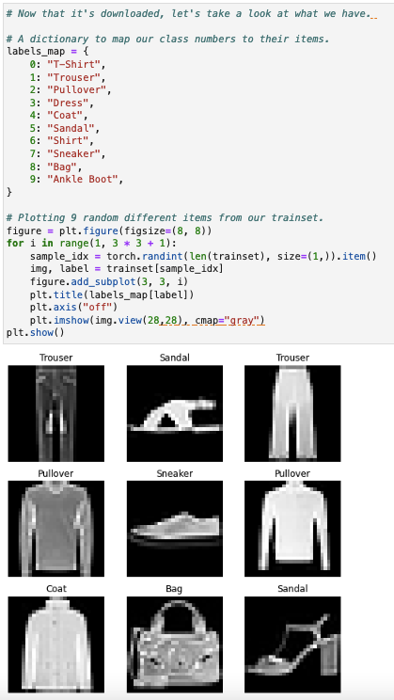
The Python code can display a few pictures from the FashionMNIST dictionary and sample data set.

Slide 12
Destination
There are ten classes of fashion items (e.g. shirt, shoes, and so on). Our goal is to identify which class each picture falls into. Now you can train the model and determine how well it classifies the items:

Slide 13
Load and run a PyTorch model
In the getting-started-with-gpus directory, double click on the torch-test-model.ipynb file

Slide 14
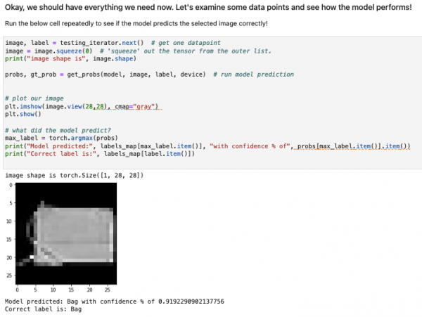
The model classifies a picture as a bag

Slide 15
This shows how PyTorch used in applications like image recognition and language processing

